Slide 1

Mathematics of ML and Intro to Numpy
Michigan Hackers Machine Learning Team

Slide 2
Agenda
Announcements
AI News of the Week
Review
Intro to Linear Algebra
Introducing NumPy
Work and ask questions

Slide 3
Club Announcements
Office Hours will be held from 4:30-6:30 pm every Sunday.
Zoom link can be found in Meeting Schedule
Sign-up for O’reilly Media
O’reilly Media is free for umich students, so please log in to it to use Data Science from Scratch textbook and Hands-On Machine Learning.
Become a core-member
If you have attended the last three meetings in a row, you can become a core member

Slide 4
General Announcements
MDP Applications are now open!
The multidisciplinary design program is an opportunity for undergraduate students to participate faculty led research or industry sponsored teams to work on impactful projects and gain meaningful experience in academia or industry.
Data Science in Politics Seminar
Meet David Shor, a Super-Pac Data Scientist and learn about how data science and machine learning is being used in this election from data analysis to cybersecurity. Hosted by MIDAS.
Friday Night AI
A series of seminars hosted by the Michigan AI Lab about a wide variety of topics. The next one is on October 2nd about Artificial Intelligence to Address Misinformation and Fake News

Slide 5

AI News of the Week
OpenAI licenses their state-of-the-art natural language model GPT-3 to Microsoft for enterprise use.
Article on AI News
OpenAI Blog Post
Breakout into small groups and discuss the effects this may have.

Slide 6
Review

Slide 7
Review Questions
Q: True or false: All artificial intelligence (AI) uses machine learning.
A: False. Most AI does not use machine learning.

Slide 8
Review Questions
Q: How are the inputs to supervised and unsupervised learning algorithms different?
A: Supervised learning has labeled data as an input, unsupervised learning has unlabeled data as an input.

Slide 9
Review Questions
Q: Give an example of a possible input into a supervised learning algorithm.
A: One possibility could be an image with a cat in it labeled “cat”.
Another possibility could be birth weight labeled with adult height.
Bonus: Decide if each of these examples would be used in a regression or classification problem, and explain why.

Slide 10
Review Questions
Q: Which of the following is a valid way to make your Python program output “Hello, World!”
print “Hello, World!”
print(Hello, World!)
cout << “Hello, World”
print(“Hello, World!”)

Slide 11
Introduction to
Linear Algebra

Slide 12
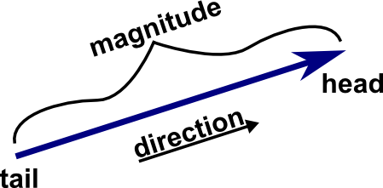
Definitions
Linear algebra is the branch of mathematics that deals with vector spaces.
A vector space is a collection of objects called vectors, which may be added with one another and multiplied by scalars. Ex: R^3
A scalar is a singular value represented by a real or complex number. Ex: x = 6
A vector is a mathematical quantity that has both direction and magnitude. It is commonly represented as a directed line segment whose length represents the vector’s magnitude and orientation represents its direction. Ex: a = [2, 1]

Slide 13
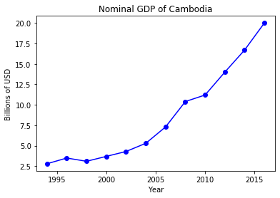
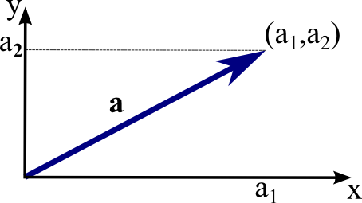
Representing Data as Vectors
Points in some finite-dimensional space can be represented by vectors.
From our previous example of Annual Nominal GDP per Year, the data can be seen as a set of two-dimensional vectors [year, GDP].
Storing data points as vectors allows us to perform operations and calculations on the data which is used in machine learning algorithms,

Slide 14
Vector Operations
Let a = [a_1, a_2, a_3, …, a_n] and b = [b_1, b_2, b_3, …, b_n] be two vectors in n dimensional space.
Addition: Adding and subtracting of vectors is component wise, commutative, and associative.
a + b = [a_1+b_1, a_2+b_2, …, a_n+b_n]
[1,2,3] + [4,5,6] = [5,7,9]
Vectors must be the same dimension to be summed. This means you cannot add a scalar (1D) to a vector (>1D)
Scalar Multiplication: Vectors can be multiplied by scalars and is done component-wise
4a = [4*a_1, 4*a_2, 4*a_3, …, 4*a_n]
3*[1,2,3] = [3,6,9]

Slide 15
Vector Operations
Let a = [a_1, a_2, a_3, …, a_n] and b = [b_1, b_2, b_3, …, b_n] be two vectors in n dimensional space.
Dot Product: the sum of the products of the components of vectors
a ᆞb = a_1*a_b + a_2*b_2+a_3*b_3+...+a_n*b_n
[1,2,3] ᆞ [5,-2,0] = 1*5 + 2*(-2) + 3*0 = 1
Vectors must be the same dimension to be summed
Magnitude: the euclidean distance of the vector
||a|| = sqrt(a_1^2 + a_2^2 + … +a_n^2)
||[3,4]|| = sqrt(3^2 + 4^2) = sqrt(25) = 5

Slide 16

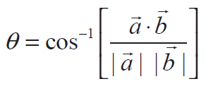
Vector Operations
Projection:
Angle Between Two Vectors:
Distance:
dist(a,b) = sqrt((a,b)ᆞ(a,b))

Slide 17
Introduction to NumPy

Slide 18
Introduction to NumPy
A Python library is a collection of files which contain useful data structures and functions you can reference while coding
NumPy is a Python library
The data structures and functions in NumPy allow us to do linear algebra in our Python scripts.

Slide 19
Installing Numpy
Open terminal > conda activate > conda install numpy

Slide 20
Create a Jupyter notebook
Navigator: Anaconda Navigator > Jupyter > “New” > Python 3
Terminal: conda activate > jupyter notebook > “New” > Python 3

Slide 21
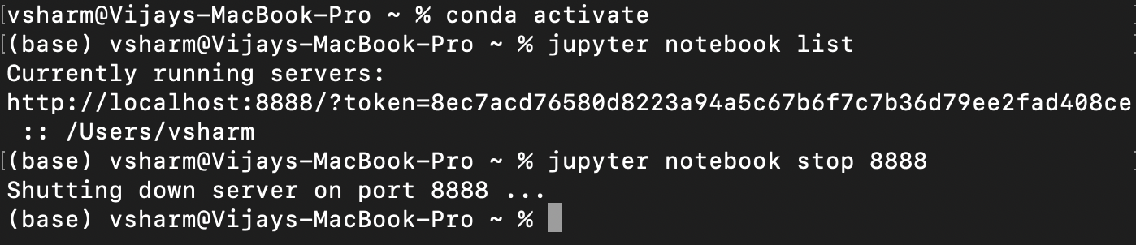
Closing Jupyter Notebook
From Window: Click “Quit”
Terminal: Ctrl-C > y > conda deactivate
Closing all Jupyter Notebook servers:
Open terminal > conda activate > jupyter notebook list
> jupyter notebook stop <port number>
port number

Slide 22
Work and Ask Questions

Slide 23
Work and Ask Questions
Questions about any topic, onboarding, or computer setup
For next week:
Beginner: Week 2 of Python 3 Programming Specialization on Coursera. Use the practice feature of the interactive textbook
Intermediate: Read chapters 4 and 5 in DSFS. Do examples in jupyter notebooks.
Advanced (already familiar with Python): Do the first project in Hands On Machine Learning, do pandas and numpy Kaggle tutorials, do Kaggle introductory competition (any of the above)

Slide 24

Thank You!
Michigan Hackers Machine Learning Team
Contact Info:
Rajas Gupta | rajasg@umich.edu
Vijay Shamra | vsharm@umich.edu
Provide Feedback

